Slide 1
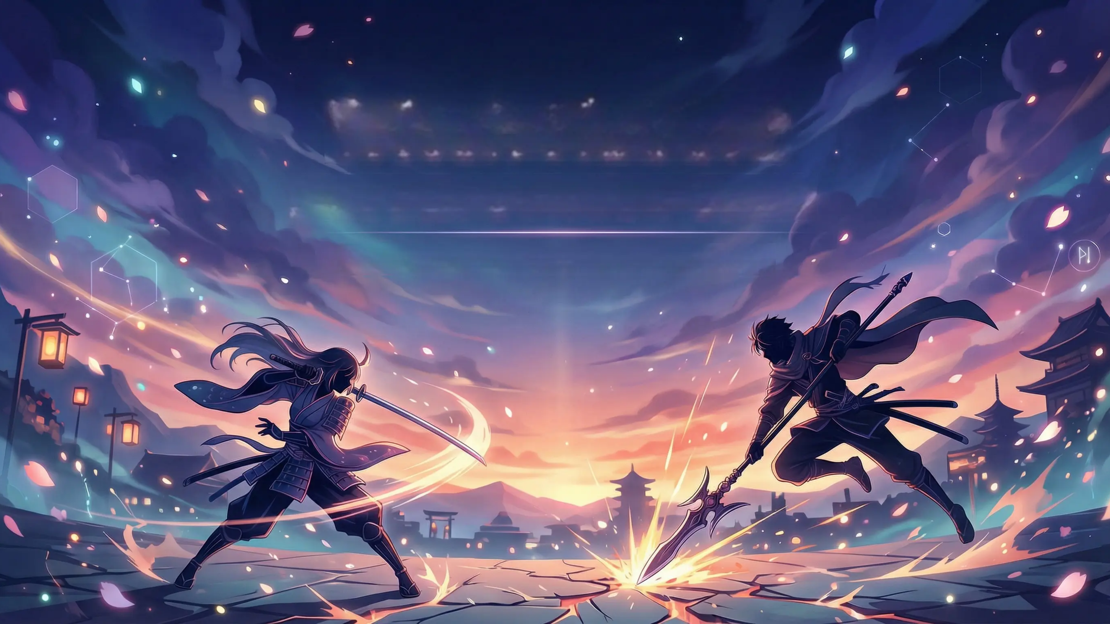
Witch Rabbit: An Anime Action Game
A Final Year Project Inspired by Sekiro.

Slide 2
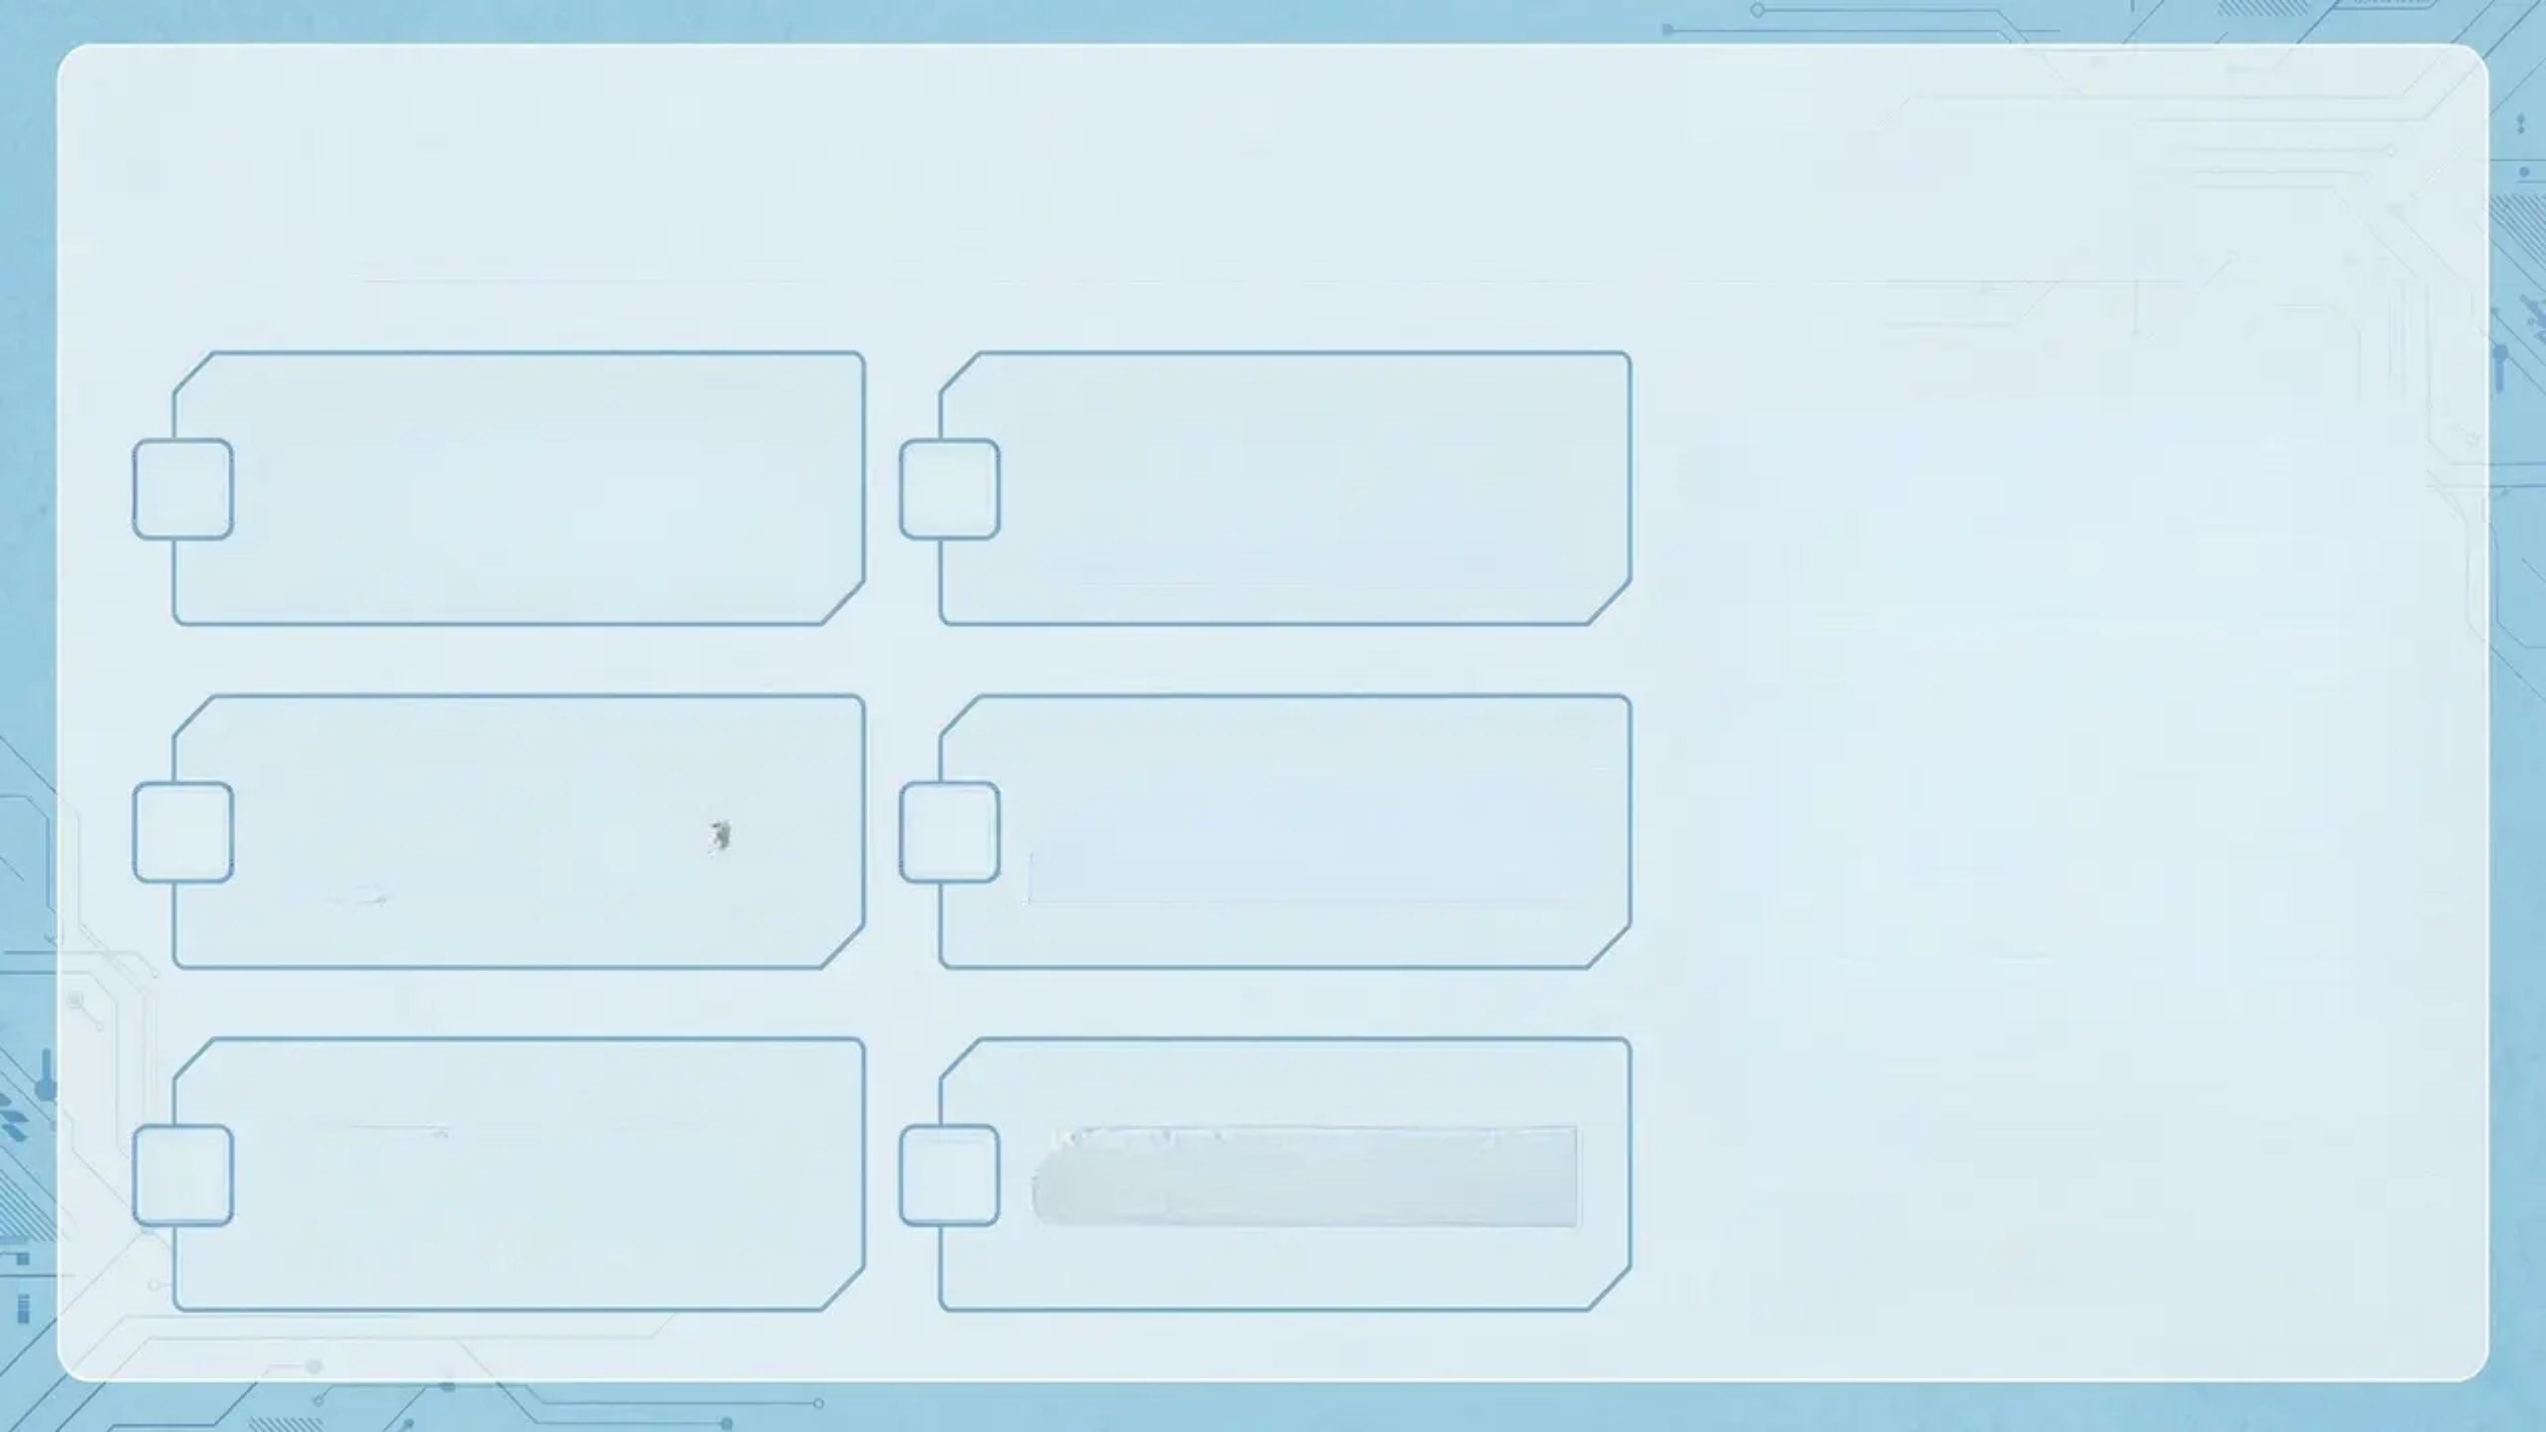








Project Overview & Core Concept
This is a third-person action game. It mixes Sekiro's precise combat with beautiful anime art.
We use Unreal Engine 5.5, with both C++ and Blueprints.
You'll see Touhou characters in lovely 3D worlds.
The key is to master parries and posture battles.
Play as Reimu Hakurei and fight strong enemies.
Enjoy the mix of 2D anime looks and 3D action fun.
5.5
C++ | Blueprint

Slide 3
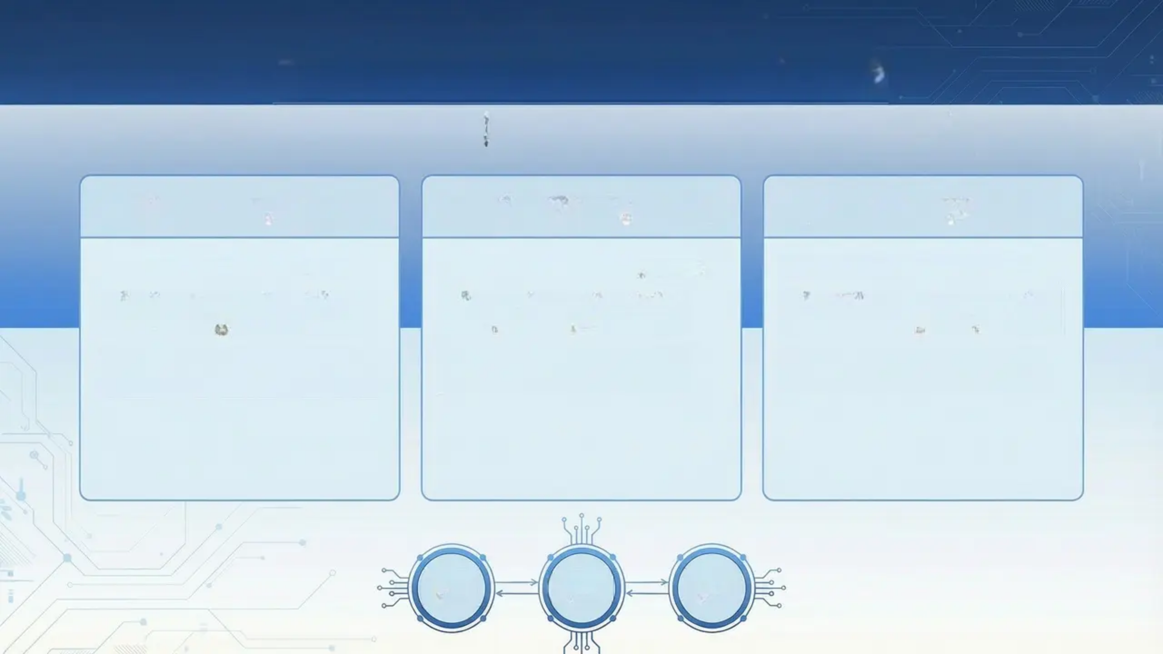
Technical System Highlights
22 C++ Source Files | ~760 Lines in Core Character Class
Combat System
Deflection System
Posture System
• SekiroCombatComponent • Orchestrates attack flows and damage. • Syncs battle logic smoothly with animations.
• SekiroDeflectComponent • Rewards precise timing for perfect parries. • Instant visual feedback confirms success.
• SekiroPostureComponent • Real-time posture tracking adds strategic depth. • Breaking posture triggers decisive executions.

Slide 4
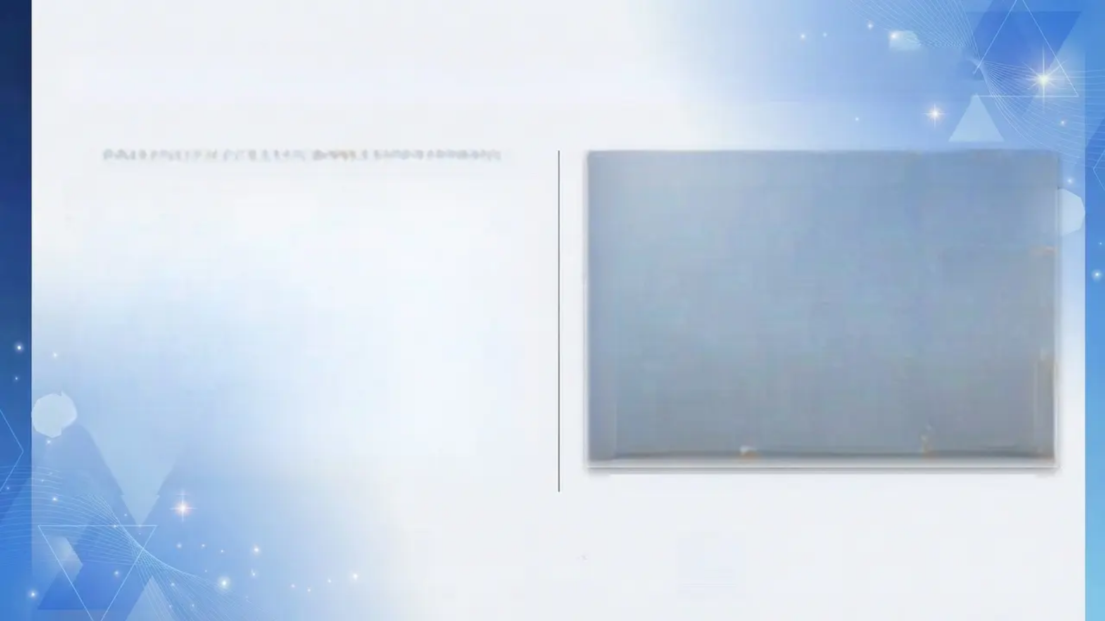
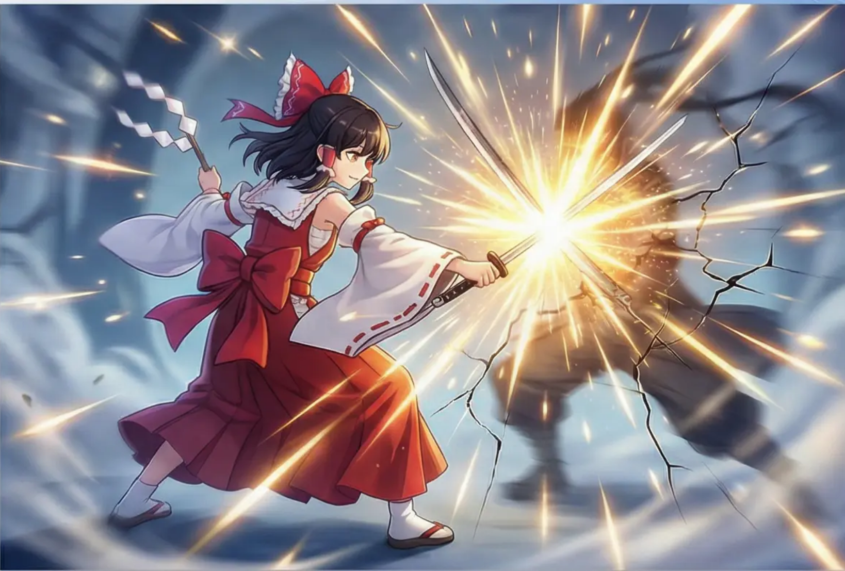
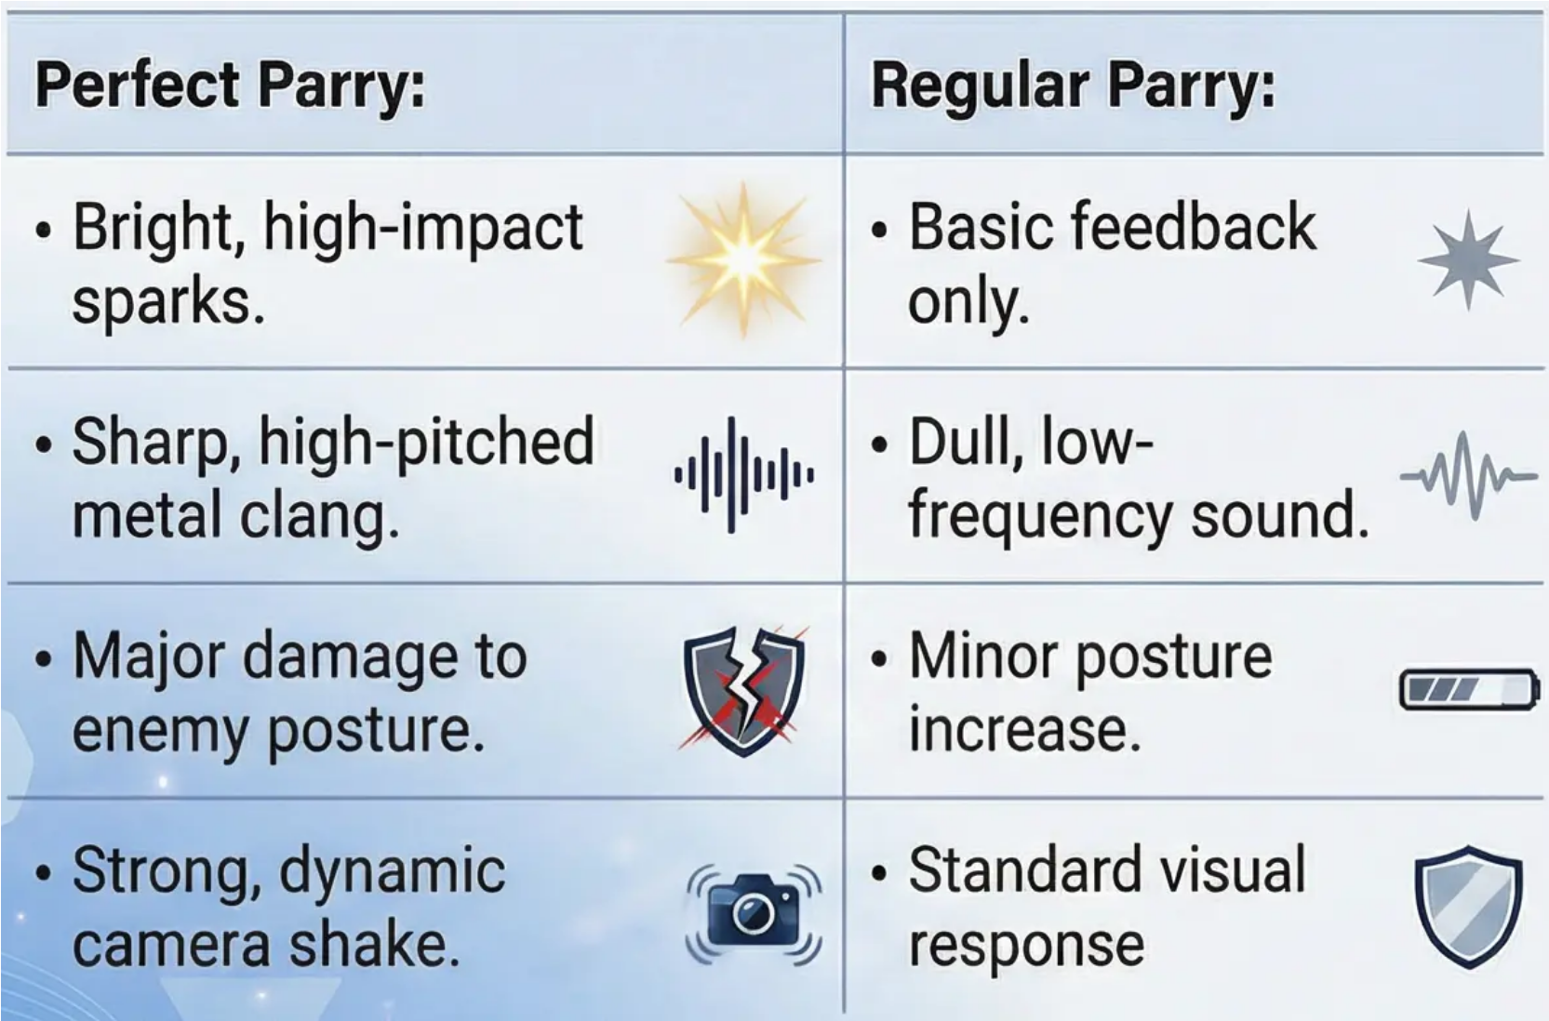


Perfect Parry: Visual & Audio Feedback
PERFECT PARRY vs REGULAR PARRY
Technical Note: Implemented in C++ function HandleParryResult
Visual Feedback
Audio Feedback
Camera Shake

Slide 5
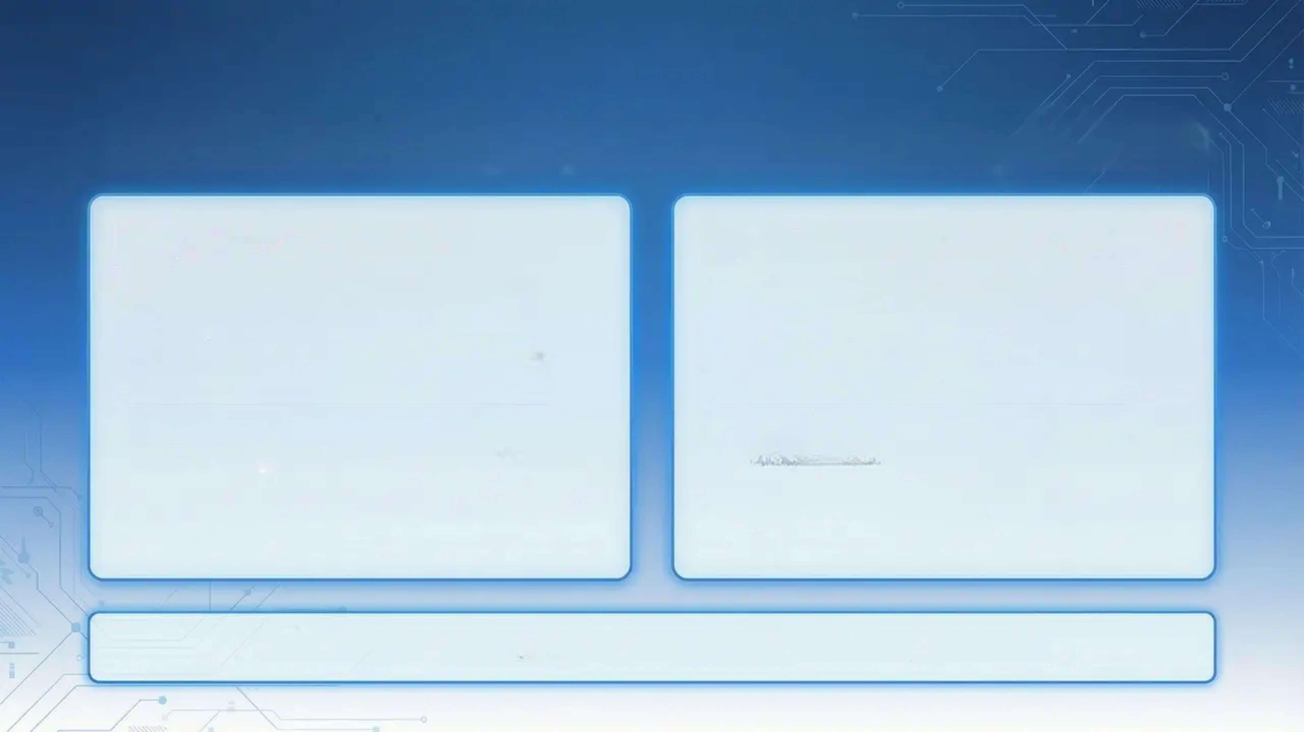


Academic Integrity: AI & Third-Party Assets
AI Tool Assistance
Third-Party Resources
• AI aided code generation and bug fixing.
• Community models and animations were integrated.
• Tools guided our visual effects and animations.
• Audio came from established free libraries.
• GitHub support was utilized.
• Unreal Nanite enhanced the environment.
• We openly disclose all AI assistance.
• All external assets are clearly credited.
We follow CityU's policy by disclosing all AI and third-party resources.

Slide 6
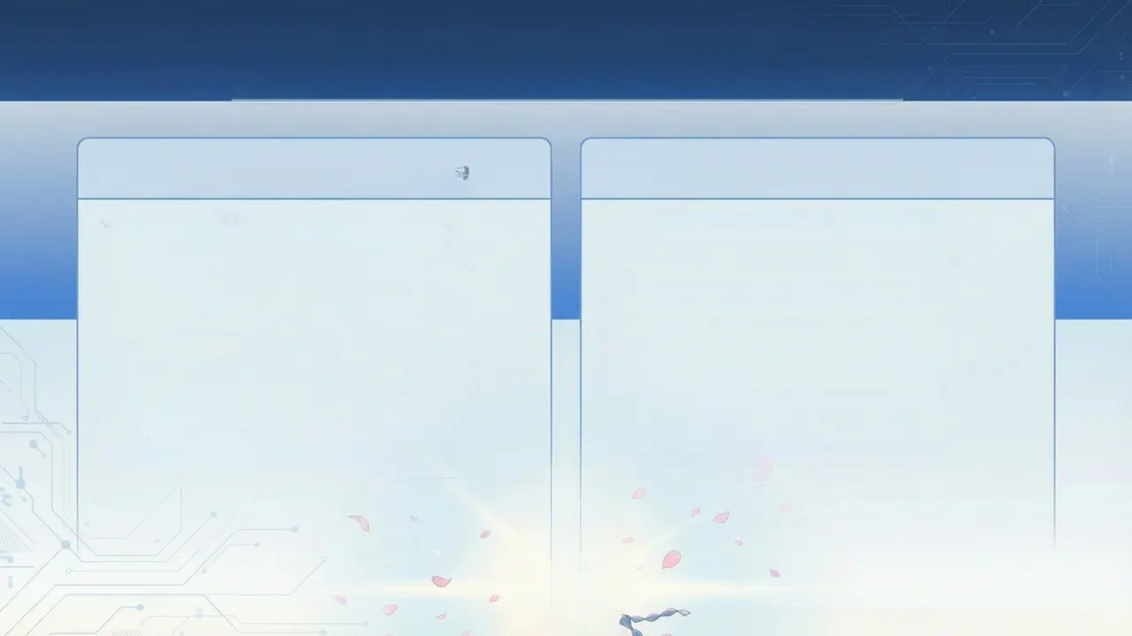

Results & Future Development
Project Achievements
Future Development
Created Sekiro-style combat prototype. Wrote extensive C++ code for character. Added anime VRM characters. Built precise parry and posture systems. Achieved anime cel-shading. Validated AI workflow.
More VRM character models. Add dynamic music system. Optimize for mobile with LOD. Automate testing and level generation. Add skill trees and customization. Introduce multiplayer co-op.
City University of Hong Kong - SCM Final Year Project 2026

